Slide 1
Movie Gross Prediction(Anjana Tiha)
Features used:
Text Features : Top 3 Actors, Director, Country, Content Rating, Language.
Numerical Features : Facebook Likes of Top 3 Actor and Director and Total Facebook Likes for Cast, Budget
Preprocessing:
Text Features features are transformed to Categorical features by Labeling and Binarizing.
Numerical features scaled to (0 - 1)
Aggregate Binarized Categorical data and scaled Numerical data for training
Rows not without gross or major features was remove

Slide 2
Movie Gross Prediction Process:
Preprocessing , Model Training and Validation
Categorical (Text) Data Labeled
Labels are Binarized
Binarized Text and Numerical Aggregation
Model Training
Evaluation
Numerical Data Extract
Min-Max Scaled

Slide 3
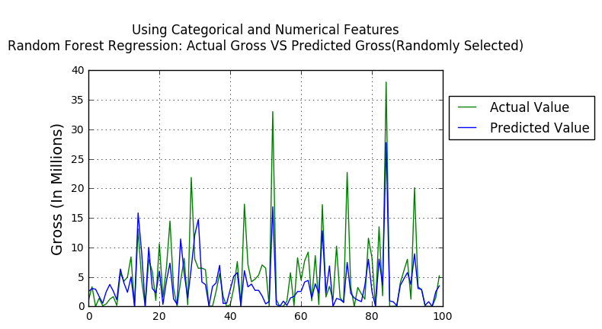
Regression Model and Evaluation
Regression Model:
Random Forest Regression
Decision Tree Regression
Other Regression Models Tried: Support Vector Machine Regression and Linear Regression
Evaluation | Random Forest | Decision Tree
Mean Square Error | 0.0048 | 0.0065
Mean Absolute Error | 0.0396 | 0.0457
R Square Error | 0.4755 | 0.217

Slide 4
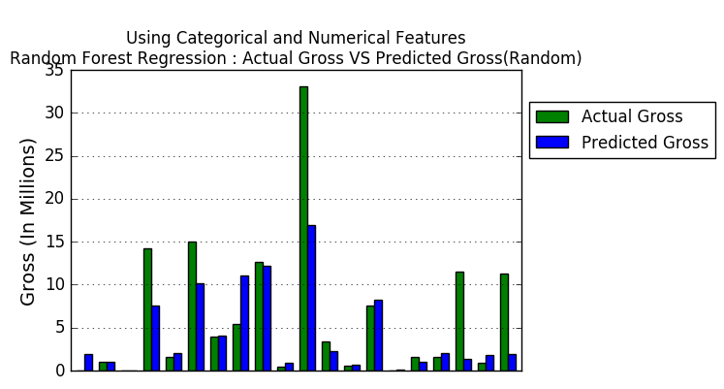
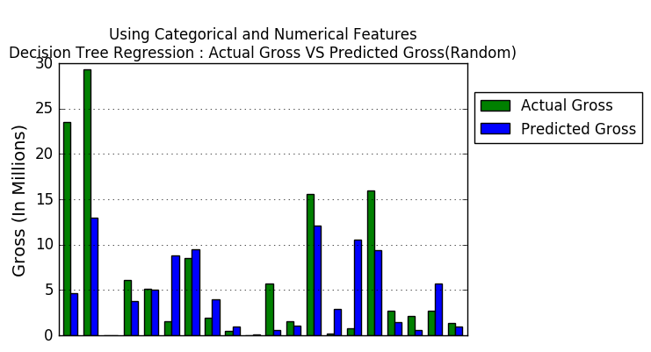
Visualization

Slide 5
Any Question??

Slide 6
Thank You

